Slide 1

Data Communication and
Networks
K.Murugan

Slide 2
Network Layer
Address Mapping

Slide 3
Introduction
Internetwork is made of LANs and WAN.
There are two type of addressing: Logical addressing and physical addressing
Physical address is the MAC (Media Access Control) address that is burned into the network interface card (NIC). That address is unique and is used to find devices within a LAN. It uses a 48bit address
Logical addressing is called as IP Address.
A Logical address is a 32- bit address assigned to each system in a network.
IP was designed as a best-effort delivery protocol, but it lacks some features such as flow control and error control.

Slide 4
Introduction
It is a host-to-host protocol using logical addressing.
To make IP more responsive to some requirements in today's internetworking, we need the help of other protocols.
need protocols to create a mapping between physical and logical addresses.
For this purpose the protocols like ARP, RARP, BOOTp, and DHCP are designed.

Slide 5
Address Mapping
An internet is made of a combination of physical networks connected by internetworking devices such as routers.
A packet starting from a source host may pass through several different physical networks before finally reaching the destination host.
The hosts and routers are recognized at the network level by their logical (IP) addresses.
However, packets pass through physical networks to reach these hosts and routers.
At the physical level, the hosts and routers are recognized by their physical addresses.

Slide 6
Need for Address Mapping
The physical address and the logical address are two different identifiers.
We need both because a physical network such as Ethernet can have two different protocols at the network layer such as IP and IPX (Novell) at the same time.
Likewise, a packet at a network layer such as IP may pass through different physical networks such as Ethernet and LocalTalk (Apple).
This means that delivery of a packet to a host or a router requires two levels of addressing: logical and physical.
We need to be able to map a logical address to its corresponding physical address and vice versa.
These can be done by using either static or dynamic mapping.

Slide 7
Static mapping
It involves in the creation of a table that associates a logical address with a physical address. This table is stored in each machine on the network.
Each machine that knows, the IP address of another machine but not its physical address can look it up in the table.
This has some limitations because physical addresses may change in the following ways:
A machine could change its NIC, resulting in a new physical address.
2. In some LANs, such as LocalTalk, the physical address changes every time the computer is turned on.
3. A mobile computer can move from one physical network to another, resulting in a change in its physical address

Slide 8
Dynamic mapping
In dynamic mapping each time a machine knows one of the two addresses (logical or physical), it can use a protocol to find the other on.

Slide 9
Mapping Logical to Physical Address: ARP
Anytime a host or a router has an IP datagram to send to another host or router, it has the logical (IP) address of the receiver.
But the IP datagram must be encapsulated in a frame to be able to pass through the physical network. This means that the sender needs the physical address of the receiver
The host or the router sends an ARP query packet.
The packet includes the physical and IP addresses of the sender and the IP address of the receiver
Every host or router on the network receives and processes the ARP query packet
only the intended recipient recognizes its IP address and sends back an ARP response packet.

Slide 10
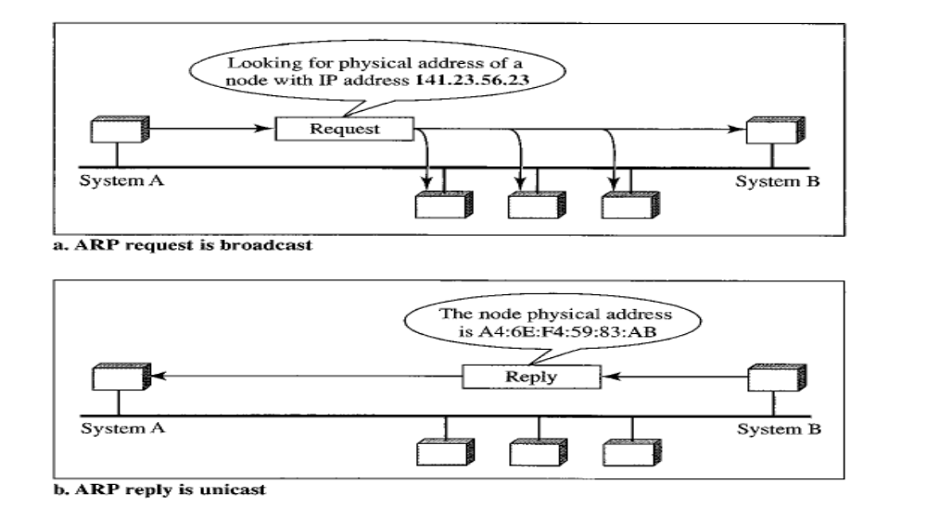
Mapping Logical to Physical Address: ARP

Slide 11
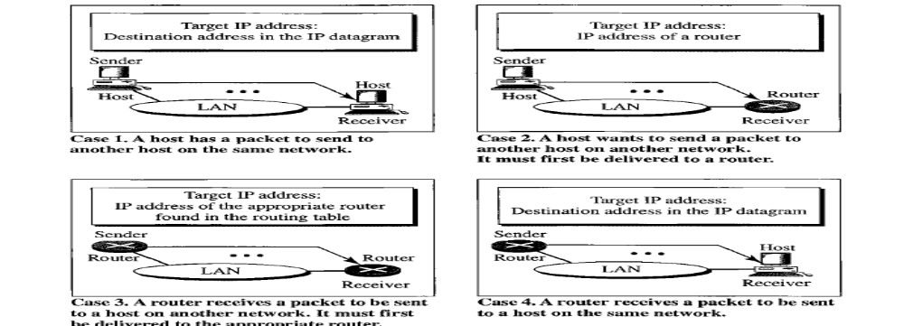
Four cases in which ARP is used
The sender is a host and wants to send a packet to another host on the same network.
In this case, the logical address that must be mapped to a physical address is
the destination IP address in the datagram header.

Slide 12
Four cases in which ARP is used
In this case, the host looks at its routing table and finds the IP address of the next hop (router) for this destination.
If it does not have a routing table, it looks for the IP address of the default router.
The IP address of the router becomes the logical address that must be mapped to a physical address.

Slide 13
Four cases in which ARP is used
The sender is a router that has received a datagram destined for a host on another network.
It checks its routing table and finds the IP address of the next router.
The IP address of the next router becomes the logical address that must be mapped to a physical address.

Slide 14
Four cases in which ARP is used
The sender is a router that has received a datagram destined for a host on the same network.
The destination IP address of the datagram becomes the logical address that must be mapped to a physical address

Slide 15
Mapping Physical to Logical Address: RARP, BOOTP, and DHCP
There are occasions in which a host knows its physical address, but needs to know its logical address. This may happen in two cases:
  1. A diskless station is just booted. The station can find its physical address by checking its interface, but it does not know its IP address.
  2. An organization does not have enough IP addresses to assign to each station; it needs to assign IP addresses on demand. The station can send its physical address and ask for a short time lease.

Slide 16
RARP
Reverse Address Resolution Protocol (RARP) finds the logical address for a machine that knows only its physical address.
A RARP request is created and broadcast on the local network.
Another machine on the local network that knows all the IP addresses will respond with a RARP reply.
The requesting machine must be running a RARP client program; the responding machine must be running a RARP server program.

Slide 17
RARP
There is a serious problem with RARP: Broadcasting is done at the data link layer.
RARP messages do not pass the boundaries of a network.
This means that if an administrator has several networks or several subnets, it needs to assign a RARP server for each network or subnet.
This is the reason that RARP is almost obsolete.

Slide 18
BOOTp
The Bootstrap Protocol (BOOTp) is a client/server protocol designed to provide physical address to logical address mapping.
BOOTP is an application layer protocol.
The administrator may put the client and the server on the same network or on different networks.
BOOTP messages are encapsulated in a UDP packet, and the UDP packet itself is encapsulated in an IP packet.

Slide 19
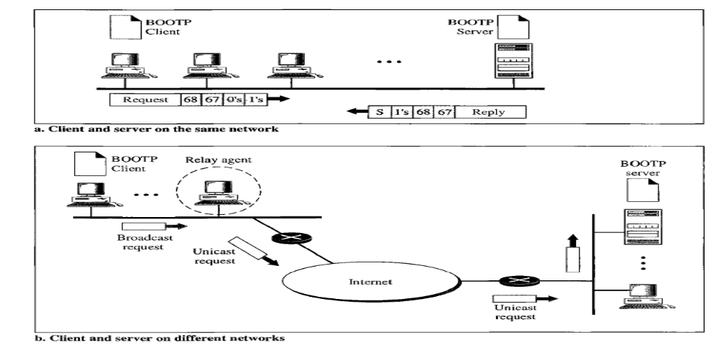
BOOTp
BOOTp can be used in same and different networks, so it make it advantageous towards RARP.

Slide 20
DHCP
The Dynamic Host Configuration Protocol (DHCP) has been devised to provide static and dynamic address allocation that can be manual or automatic.
Static Address Allocation: In this capacity DHCP acts as BOOTp does. It is backward compatible with BOOTp. A DHCP server has a database that statically binds physical addresses to IP addresses.
Dynamic Address Allocation: DHCP has a second database with a pool of available IP addresses. This second database makes DHCP dynamic.

Slide 21
DHCP
When a DHCP client requests a temporary IP address, the DHCP server goes to the pool of available (unused) IP addresses and assigns an IP address for a negotiable period of time.
When a DHCP client sends a request to a DHCP server, the server first checks its static database.
If an entry with the requested physical address exists in the static database, the permanent IP address of the client is returned.
On the other hand, if the entry does not exist in the static database, the server selects an IP address from the available pool, assigns the address to the client, and adds the entry to the dynamic database

Slide 22
DHCP
DHCP, on the other hand, allows both manual and automatic configurations.
Static addresses are created manually dynamic addresses are created automatically, Where as BOOTp should be manually configured.
This make DHCP advantageous over BOOTp

Slide 23
ICMP
The IP protocol has no error-reporting or error-correcting mechanism
The IP protocol also lacks a mechanism for host and management queries
The Internet Control Message Protocol (ICMP) has been designed to compensate for the above two deficiencies.
It is a companion to the IP protoco1

Slide 24
ICMP
ICMP messages are divided into two broad categories: error-reporting messages and query messages.
  The error-reporting messages report problems that a router or a host (destination) may encounter when it processes an IP packet.
  The query messages, which occur in pairs, help a host or a network manager get specific information from a router or another host.

Slide 25
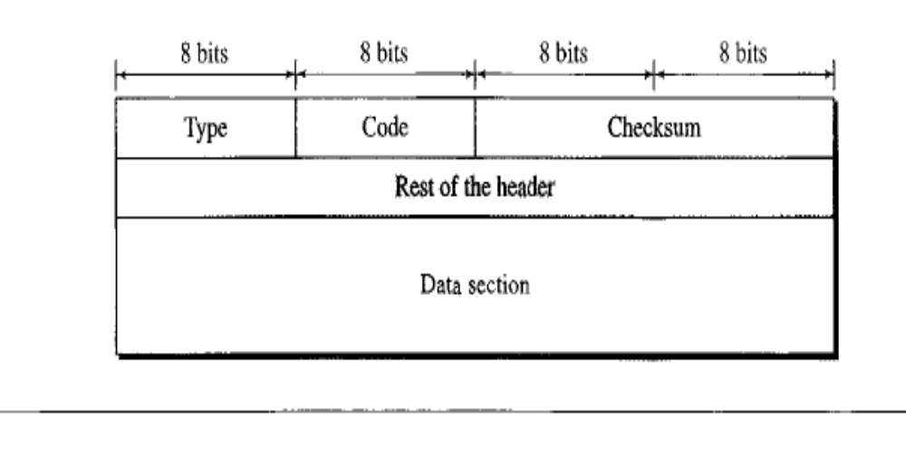
Message Format

Slide 26
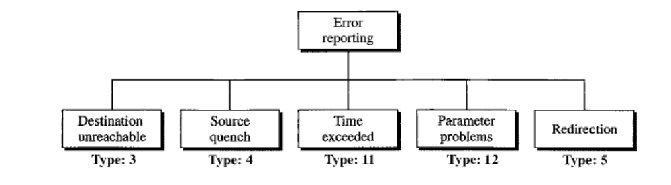
Error reporting
ICMP always reports error messages to the original source.
Five types of errors are handled: destination unreachable, source quench, time exceeded, parameter problems, and redirection

Slide 27
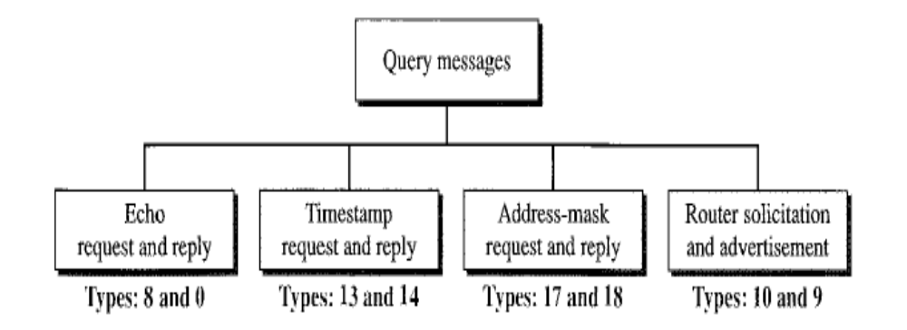
Query
In addition to error reporting, ICMP can diagnose some network problems.
This is accomplished through the query messages, a group of four different pairs of messages.

Slide 28
Debugging Tools
two tools that use ICMP for debugging: ping and traceroute.
Ping
  ping program to find if a host is alive and responding.
  We use ping here to see how it uses ICMP packets.
  The source host sends ICMP echo-request messages (type: 8, code: 0); the destination, if alive, responds with ICMP echo-reply messages
  Ping can calculate the round-trip time.
  It inserts the sending time in the data section of the message.
  When the packet arrives, it subtracts the arrival time from the departure time to get the round-trip time (RTT).

Slide 29
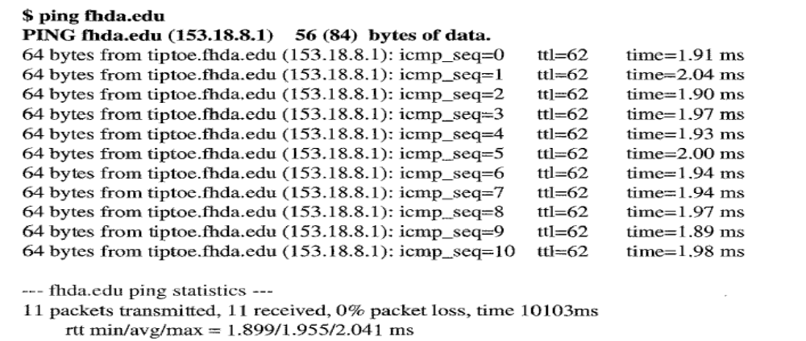
Example:

Slide 30
Traceroute
traceroute program in UNIX
tracert in Windows
used to trace the route of a packet from the source to the destination
The program elegantly uses two ICMP messages, time exceeded and destination unreachable, to find the route of a packet. This is a program at the application level that uses the services of UDP.
The traceroute program uses the ICMP messages and the TTL (time to live) field in the IP packet to find the route.

Slide 31
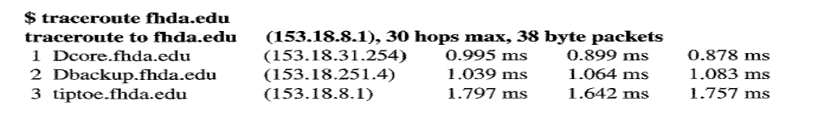
Example
The unnumbered line after the command shows that the destination is 153.18.8.1.
The TIL value is 30 hops.
The packet contains 38 bytes: 20 bytes of IP header, 8 bytes of UDP header, and 10 bytes of application data.
The application data are used by traceroute to keep track of the packets.
The first line shows the first router visited.
The router is named Dcore.fhda.edu with IP address 153.18.31.254.
The first round-trip time was 0.995 ms, the second was 0.899 ms, and the third was 0.878 ms.

Slide 32
Example
The second line shows the second router visited.
The router is named Dbackup. fhda.edu with IP address 153.18.251.4.
The three round-trip times are also shown.
The third line shows the destination host.
this is the destination host because there are no more lines.
The destination host is the server thda.edu, but it is named tiptoe.fhda.edu with the IP address 153.18.8.1.

Slide 33
IGMP
Unicasting is the communication between one sender and one receiver. It is a one-to-one communication
Some processes sometimes need to send the same message to a large number of receivers simultaneously.
This is called multicasting, which is a one-to-many communication
The Internet Group Management Protocol (IGMP) is one of the necessary, but not sufficient protocols that is involved in multicasting.
IGMP is a companion to the IP protocol.
IGMP is a group management protocol.
It helps a multicast router create and update a list of loyal members related to each router interface.

Slide 34
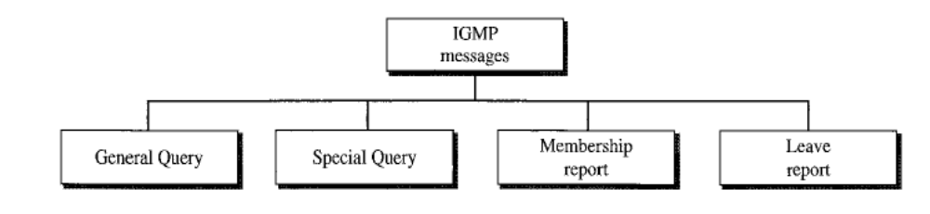
IGMP Messages
IGMP has gone through two versions.
We discuss IGMPv2, the current version.
IGMPv2 has three types of messages: the query, the membership report, and the leave report.
There are two types of query messages: general and special

Slide 35
IGMP Messages
When a process wants to join a new group, it sends its request to the host.
The host adds the name of the process and the name of the requested group to its list.
If this is the first entry for this particular group, the host sends a membership report message.
If this is not the first entry, there is no need to send the membership report since the host is already a member of the group; it already receives multicast packets for this group.

Slide 36
IGMP Messages
When a host sees that no process is interested in a specific group, it sends a leave report.
The multicast router is responsible for monitoring all the hosts or routers in a LAN to see if they want to continue their membership in a group.
The router periodically (by default, every 125 s) sends a general query message.
In this message, the group address field is set to 0.0.0.0. This means the query for membership continuation is for all groups in which a host is involved, not just one

Slide 37
ICMPv6
ICMPv4 has been modified to make it more suitable for IPv6.
The ARP and IGMP protocols in version 4 are combined in ICMPv6.
The RARP protocol is dropped from the suite because it was rarely used and BOOTP has the same functionality.
We divide the ICMP messages into two categories: Error Reporting and Query

Slide 38
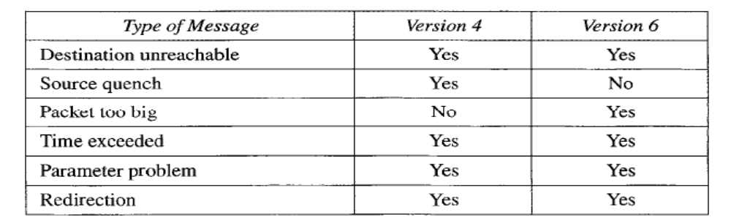
Error Reporting
Five types of errors are handled: destination unreachable, packet too big, time exceeded, parameter problems, and redirection
Fig: Comparison of Error Reporting in ICMPv4 and ICMPv6

Slide 39
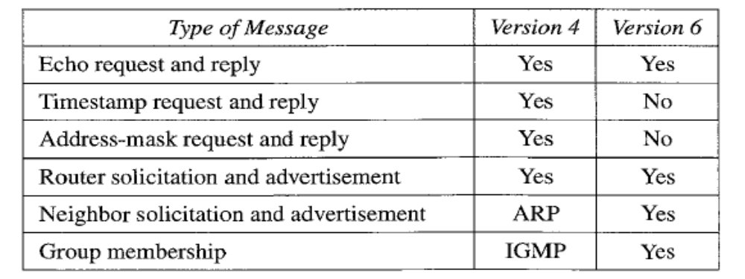
Query
Four different groups of messages have been defined: echo request and reply, router solicitation and advertisement, neighbor solicitation and advertisement, and group membership

